Slide 1

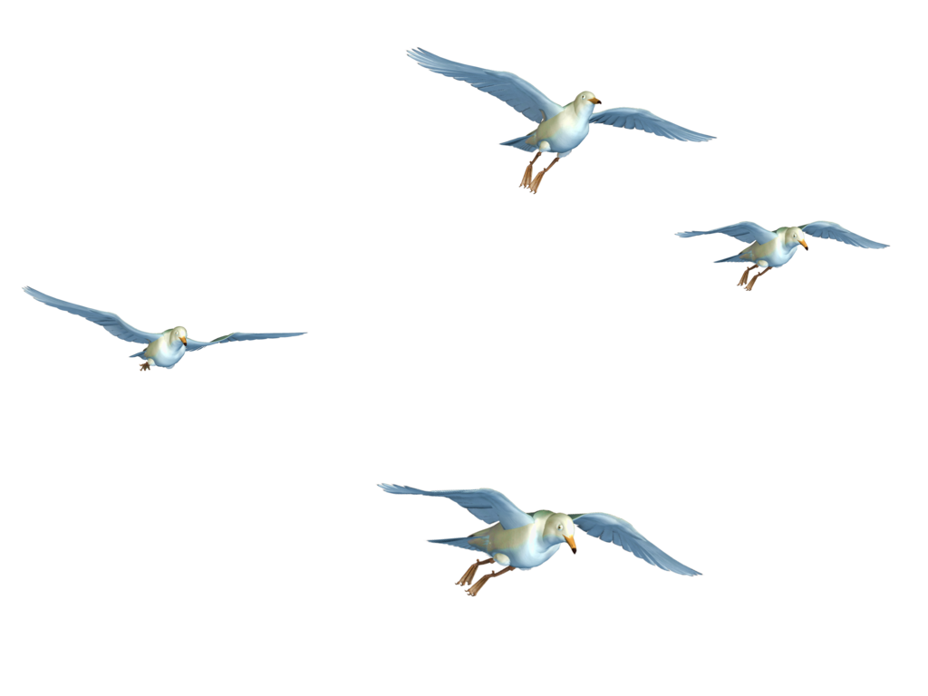


Bird Strikes Between 2000 – 2011

Slide 2
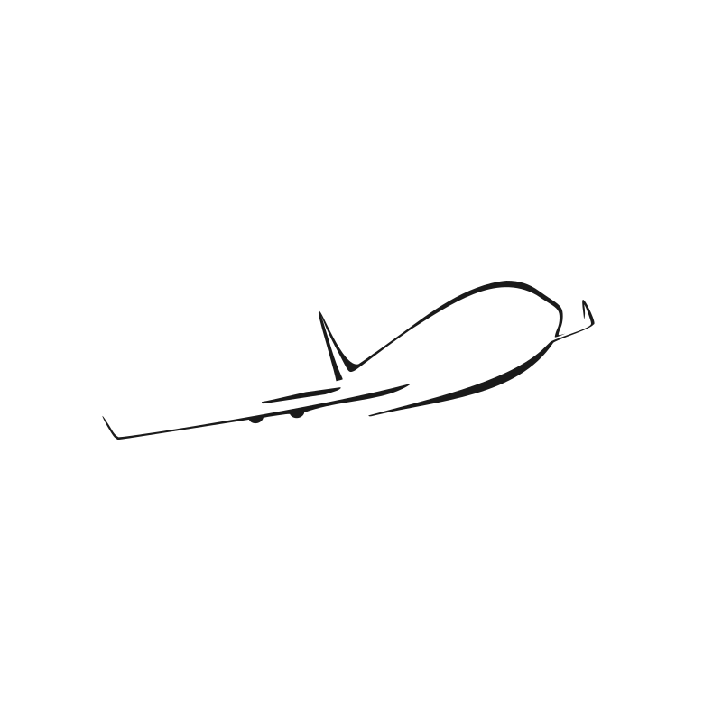

Introduction
A bird strike is strictly defined as a collision between a bird and an aircraft which is in flight or on a take-off or landing roll. The term is often expanded to cover other wildlife strikes - with bats or ground animals. Bird Strike is common and can be a significant threat to aircraft safety. For smaller aircraft, significant damage may be caused to the aircraft structure and all aircraft, especially jet-engine ones, are vulnerable to the loss of thrust which can follow the ingestion of birds into engine air intakes. This has resulted in several fatal accidents.
Bird strikes may occur during any phase of flight, but are most likely during the take-off, initial climb, approach and landing phases due to the greater numbers of birds in flight at lower levels.

Slide 3
Case Studies
Visuals Depicting the Number of Bird Strikes
Yearly Analysis & Bird Strikes in the US
Top 10 US Airlines in terms of having encountered bird strikes
Airports with most incidents of bird strikes – Top 50
Yearly Cost Incurred due to Bird Strikes:
When do most bird strikes occur?
Altitude of Aeroplan's at the time of strike
Phase of flight at the time of the strike.
Average Altitude of the Aeroplan's in different phases at the time of strike
Effect of Bird Strikes & Impact on Flight
Effect of Strike at Different Altitude
Were Pilots Informed? & Prior Warning and Effect of Strike Relation

Slide 4

Methodology
The dataset contain information for the 25558 Record ID.
Bird Strike data is from 2000 to 2011.

Slide 5

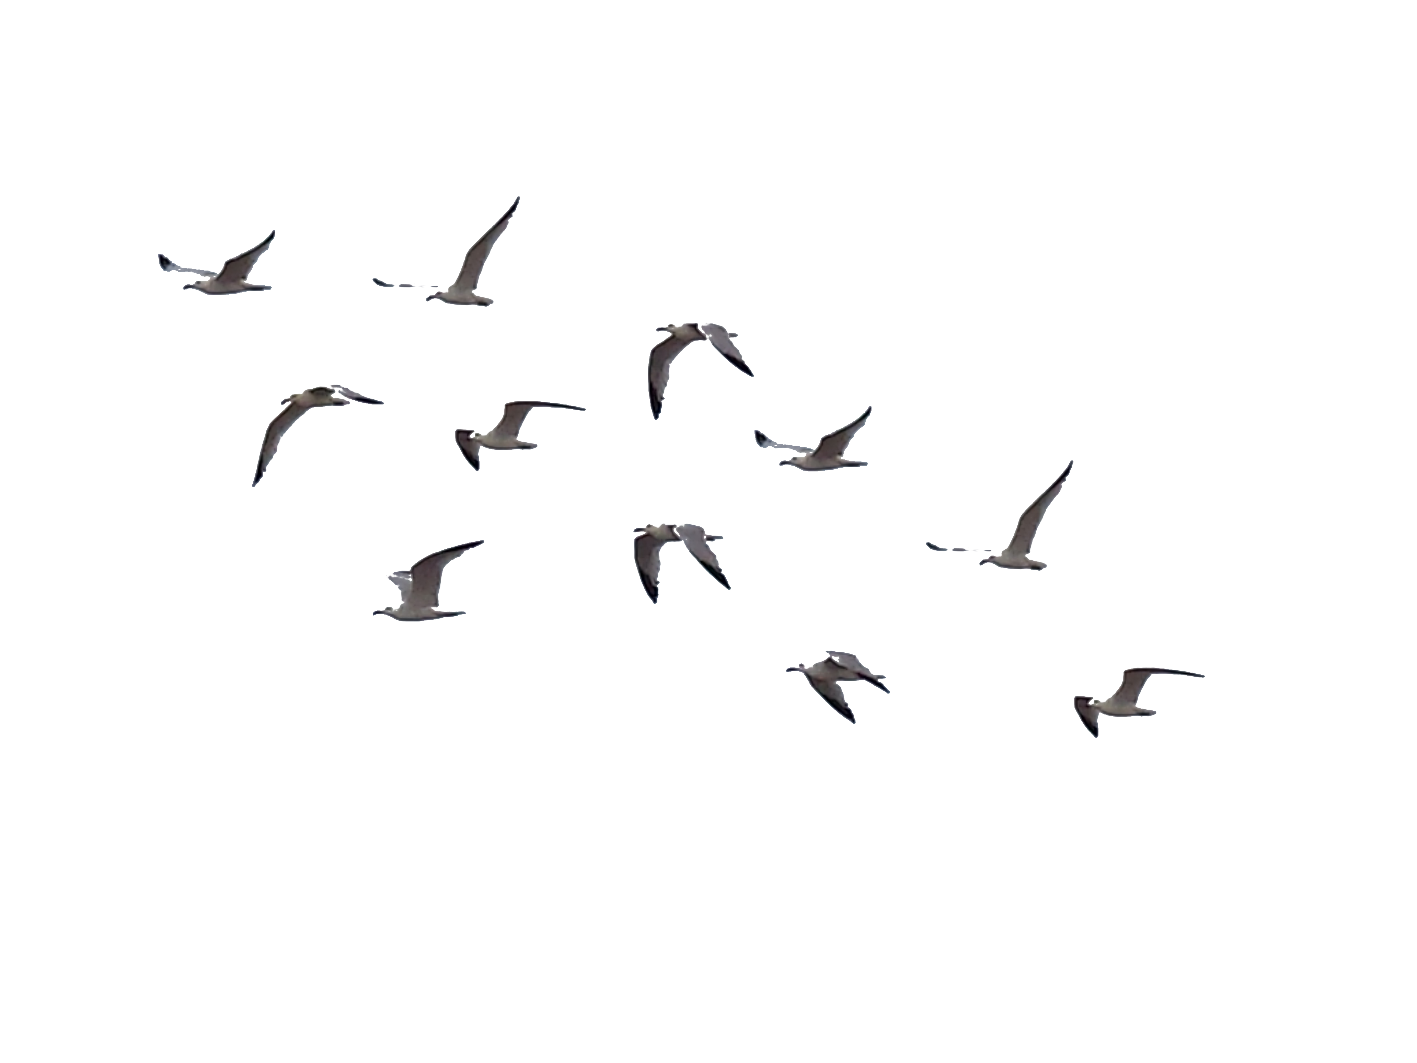
Data Preprocessing
Data exploration is the first step of data analysis and it is used to explore and visualized data to take any necessary actions. Based on our understanding of the data we can go with the appropriate data cleaning.
I used Jupyter Notebook for Data Cleaning : NumPy & Pandas
Loaded excel file into Jupyter Notebook.
There where total 25558 rows and 26 columns.
In our dataset almost in 15 columns contains NULL values.
I dropped 14 columns null values using dropna() .
I dropped Remarks column using drop() function because it contains 4605 null values.
After cleaning there are total 24747 rows and 25 columns.
Then I converted Jupyter to excel format using df.to_excel (“……Path of storage……”).

Slide 6
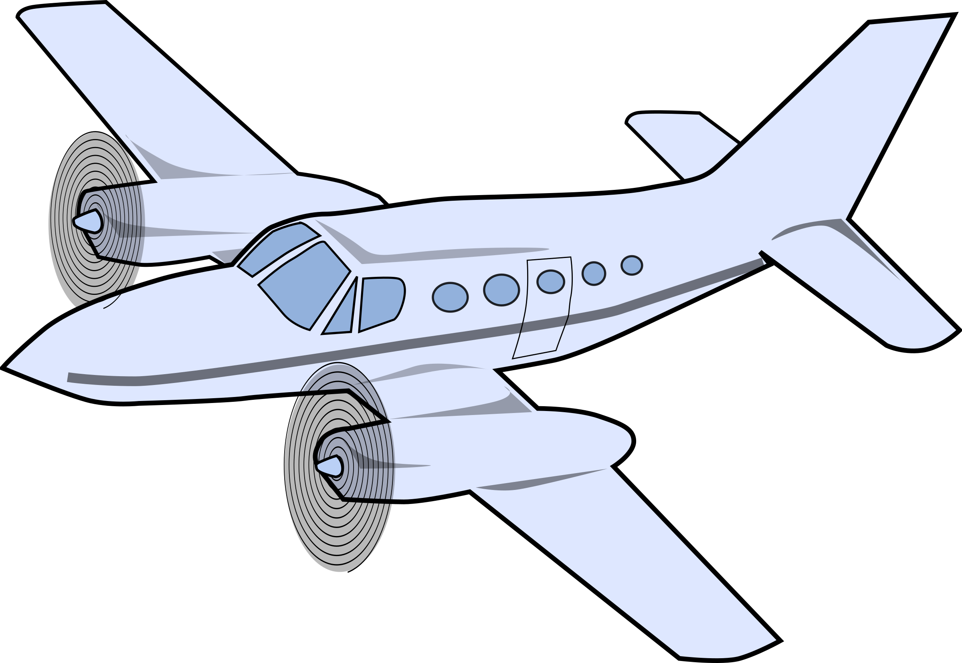
Data Visualization
I have used Power BI tool to visualize the data available to gain meaningful insights and better understand the dataset. I have used different visualizations like bar graphs, line graphs, Cards, Table, Funnel, Donut chart and Slicer which are available in the tool.

Slide 7
Conclusion
43.06% incidents where pilot was warned about the birds.
Prior warning to the pilot reduces the risk of damage to the aircraft.
SOUTHWEST AIRLINES has encountered highest birds strike :4628
52.78% of incidents have happened due to some small unknown bird.
90.37% incidents caused no damage while 9.63% incidents caused damage.
80.72% of bird strike incidents have happened when the altitude of airplane was <1000 ft and 19.28% have happened when altitude was >1000 ft.

Slide 8
Thank You

